Slide 1
Applying reinforcement learning to Tetris
Imp : Donald Carr
Guru : Philip Sterne

Slide 2
Visions plaguing a minute older you
Reinforcement Learning recap
Tetris State Space
Progress
  Tetris
  Reduced Tetris
  Contour Tetris
  Full Tetris
Game plan

Slide 3
Reinforcement Learning
A dynamic approach to learning
  Agent has the means to discover for himself how the game is played, and how he wants to play it, based upon his own interpretation of his perceptions.
  We reserve the right to punish him when he strays from the straight and narrow
Buzz free :
  Pertaining to an operation that occurs at the time it is needed rather than at a predetermined or fixed time. IBM.

Slide 4
Reinforcement Learning Crux
Agent
  Perceives state of system
  Has memory of experiences – Value function
  Functions under pre-determined reward function
  Has a policy, which maps state to action
  Constantly updates his value function to reflect continual experiences
  Possibly holds a (conceptual) model of the system
  Plugs into a game just as a Player would

Slide 5
Tetris via classical reinforcement learning
200 grid elements (blocks) in classic Tetris Well
Each block in the well could either be filled or empty
2^200 different well configurations - states

Slide 6
Consider the club
2^200 vast beyond comprehension
The agent would have to hold an opinion about each state, and remember it
Agent would also have to explore each of these states repetitively in order to form an accurate opinion
Pros : Familiar
Cons : Storage, Exploration time, redundancy

Slide 7
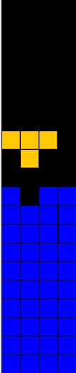
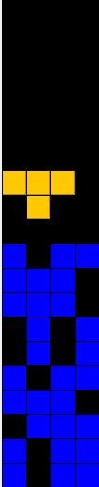
Redundancy

Slide 8
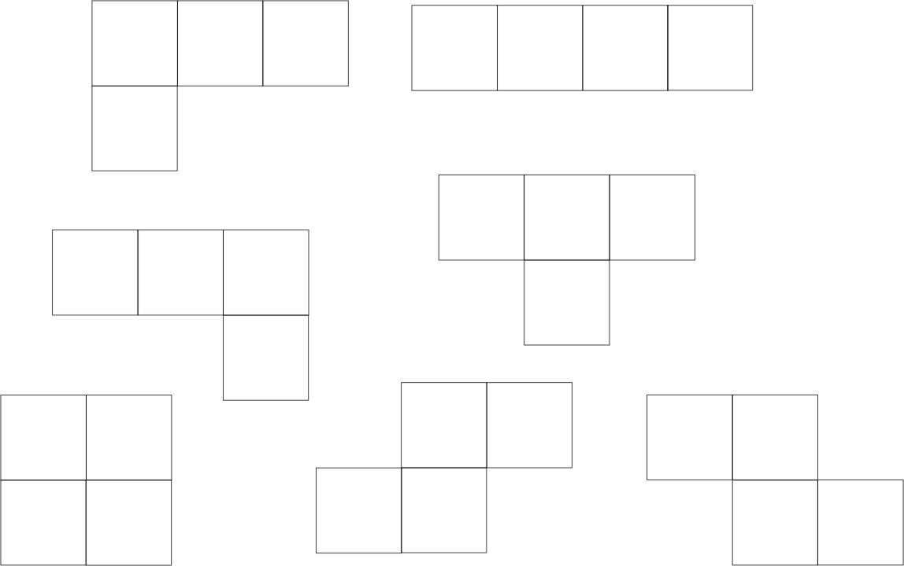
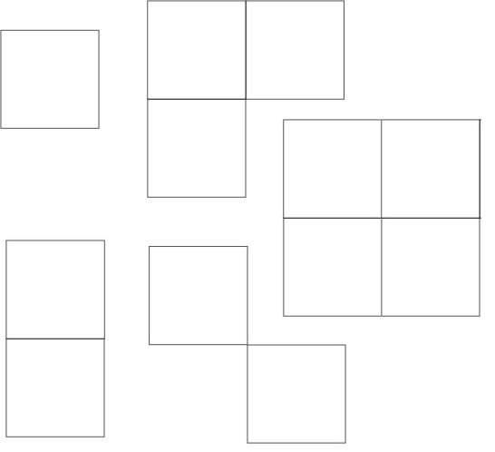
Tetrominos

Slide 9
My take on Tetris
Coded Tetris from first principles
Used Java throughout
Utilise threads, use Swing for interface
Tried to obey Object Orientated principles
Using Flyweight design pattern to alleviate computation expenses. Create each orientation of each Tetromino once, and pass pointer out when Tetromino re-requested

Slide 10
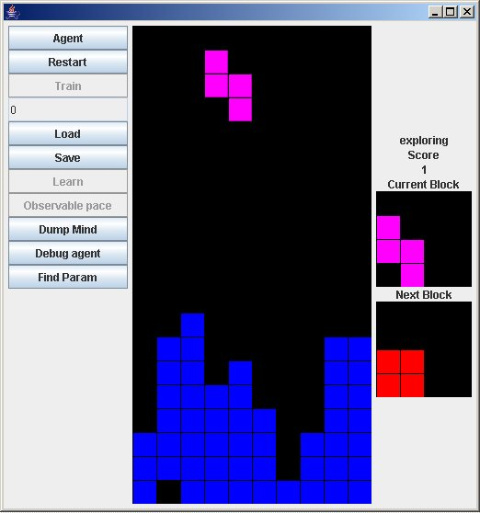
My Tetris

Slide 11
Classes : Object Orientated Tetris
Player (Plays whatever game provided)
Tetris Window (Displays whatever game provided)
Tetris Game (Plays game with pieces describe by Tetromino Source)
Tetromino (Shared Struct)
Tetromino Source (Defines nature of Tetrominos)

Slide 12
Pluggable
Different player types can be plugged in :
DeterministicPlayer, ReducedRLPlayer, ContourRLPlayer and FullPlayer
Different Games can be specified
  Conceptual
  Real (dimensions)
TetrominoSource
  Reduced blocks, full blocks, etc
  Rotations etc

Slide 13
Accurate Tetris
Rotations and movements restricted accurately within confines of well and Tetromino structure
Accurately
  Gauges Collision
  Combination
  Reduction
  Score
Robust version of Tetris

Slide 14
Interaction
Agent interacts with exact same methods as player’s TetrisWindow, and instantiated within the TetrisWindow. Therefore game oblivious to who is playing

Slide 15
Reduced Tetris
Successfully implemented reduced agent
2*6 well with reduced piece set
Therefore 2^12 state space : 4096
When height is increased above 2, agent is punished and the height is shifted down until it is at 2
Game lasts for a certain number of tetrominos : 10000 in my case
Temporal difference learner, using Sarsa as described in Sutton & Barto, and confirming Melax’s, and Bdolah & Yael’s results

Slide 16
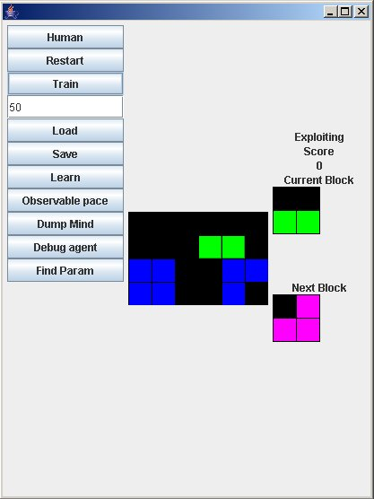
Reduced Tetris

Slide 17
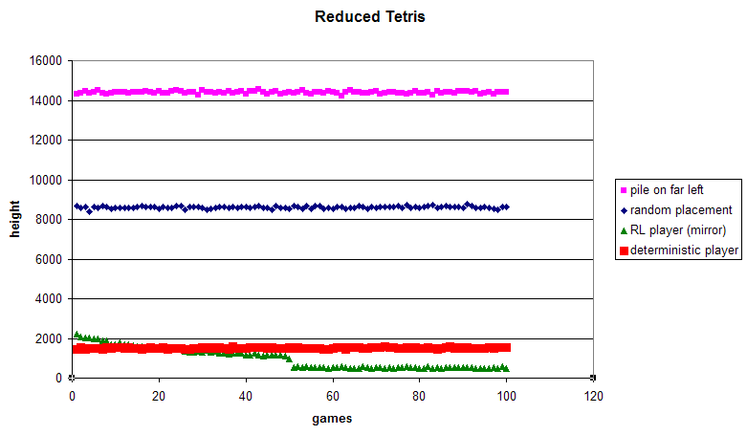
Reduced Tetris : Small is good

Slide 18
Core : Hashing the well
Each state leads to table entry
Use perfect hash function to reach into table
Pass hash function description of well formation. If square occupied add value of square to total, value of squares go up with 2^position. ( 0 <= position < 12)
  ie hash value of empty well is 0
  Hash value of full well is 2^12 – 1
Mirror sym is used at this point

Slide 19
Mirror Sym
Work out hash function value
Work out reverse hash function value
Choose smaller return as hash function value
Thus mirror symmetric states should both choose the same smaller value
State therefore isn’t removed, so experiences an unmolested existence, but the required exploration of state values should be reduced, speeding up learning

Slide 20
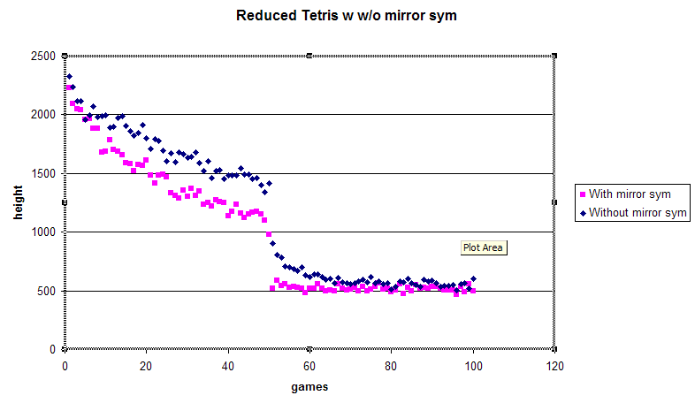
Reduced Tetris : Mirror optomisation

Slide 21
Next Stage : Contour Player
Considers well of size 4*20, with the reduced block set
Would be 2^80 using classic tabular SARSA

Slide 22
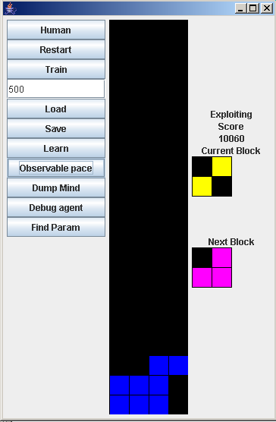
Contour Player

Slide 23
Contour Player
We all function on contours, focus on the active top layer of blocks. The heights aren’t even of paramount importance, only the contour of the well which is described by differences in height
We break the stage into divisions the width of the largest block and consider where best to put it

Slide 24
Contour Reduction
Initially 2^200 states
But there are 20^10 possible height combos
Height isn’t important, difference in height is this leads to 20^9 states
But height differences over 3 between columns are as valueless as height differences of 3, as at this point only a long piece can satisfy the height difference

Slide 25
Contour Reduction
Height differences greater then abs(+-3) therefore reduced to +- 3
Height difference can therefore be between -3 and 3, allowing 7 height differences : 7^9 states
Considering a width of 10 carries redundant information as no block is wider then 4, and we can therefore have a narrow well, considered many times across the full well

Slide 26
Final State Space
7^3 state spaces = 343 states
A disembodied agent
  Capable of learning
  Incapable of selecting the best course without further interaction, His mind does not encapsulate the full problem

Slide 27
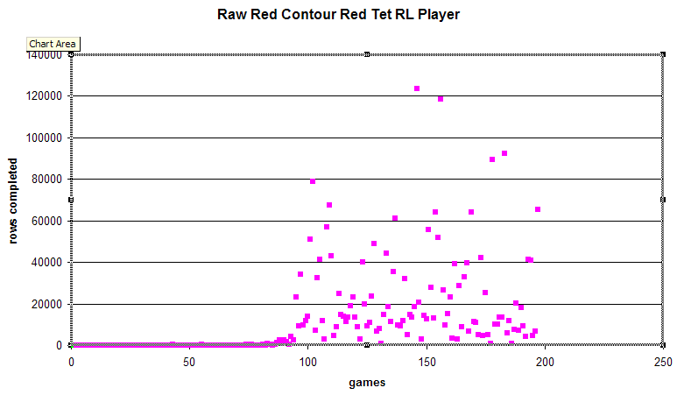
Contour Performance

Slide 28
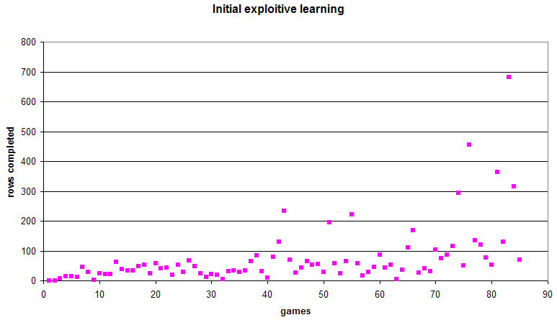
Contour Performance : Initial Zoom

Slide 29
Orchestrating a solution
Reconstructing a meaningful total state and corresponding move is a point of future, and serious, consideration
The full well has width 10, reduced well width 4.
The reduced well must be shifted across to all 6 positions to see the relative value of dropping the block in that subsection. There will then need to be a global weighting

Slide 30
Dangers include
An agent that builds solid impressive towers, rather then broadly building across the width of the well
Heading towards a deterministic player : In so much as the value function and reward function don’t supply all the information required to make an informed decision

Slide 31
Clarification
The contour method already implemented performs brilliantly with the reduced well and reduced piece set
The complete tetrominos lead to the agent playing in a lobotomised fashion. The complexity of the pieces, and therefore the opportunity to introduce covered spaces overwhelms him

Slide 32
Justification
The main loss 2^200 -> 7^3 is the loss of the position of the holes.
The only important holes however, are the ones being introduced in deciding on an action (previous holes of no interest)
This may justify including a numeric term relating the number of new covered holes, which would be used in parallel with values
Would not impede learning, would weight interpretation away from hole exacerbating transitions

Slide 33
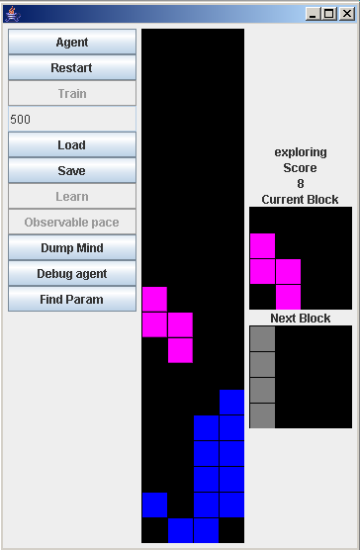
Contour full piece

Slide 34
Other implementation details
Epsilon-Greedy exploration (using)
Soft-Max selection (Intelligent exploration)
Optimistic searching (using)
Deterministic player
After-states (using)
Compared competing alternatives

Slide 35
Time management
Carry on shifting Contour Tetris towards Full Tetris
Start write-up in 1 month

